Slide 1
Introduction of Structured Learning
Hung-yi Lee
Notes:
Deep learning is method
Structured learning is problem

Slide 2
Structured Learning
We need a more powerful function f
Input and output are both objects with structures
Object: sequence, list, tree, bounding box …
X is the space of one kind of object
Y is the space of another kind of object
Notes:
Can DNN do that?

Slide 3
Example Application
Speech recognition
X: Speech signal (sequence) → Y: text (sequence)
Translation
X: Mandarin sentence (sequence) → Y: English sentence (sequence)
Syntactic Paring
X: sentence → Y: parsing tree (tree structure)
Object Detection
X: Image → Y: bounding box
Summarization
X: long document → Y: summary (short paragraph)
Retrieval
X: keyword → Y: search result (a list of webpage)
Notes:
Speech recognition 和 Translation 可能可以通过 DNN 实现，比如使用 seq2seq
但是 Syntactic Paring、Object Detection、Summarization、Retrieval 这些任务可能就不太容易使用 DNN 实现

Slide 4
Unified Framework
Energy-based Model: http://www.cs.nyu.edu/~yann/research/ebm/
Step 1: Training
Find a function F
Step 2: Inference (Testing)
Given an object x
F(x,y): evaluate how compatible the objects x and y is
Notes:
Unified Framework 统一框架
What is F? different people give it different name, Yan LaCu call it Enerygy model F 是什么？不同的人给它起不同的名字，Yan LaGu 叫它 Energy model
This framework is every where 这个框架无处不在
evaluate how compatible the objects x and y is 评估对象 x 和 y 的兼容性

Slide 5
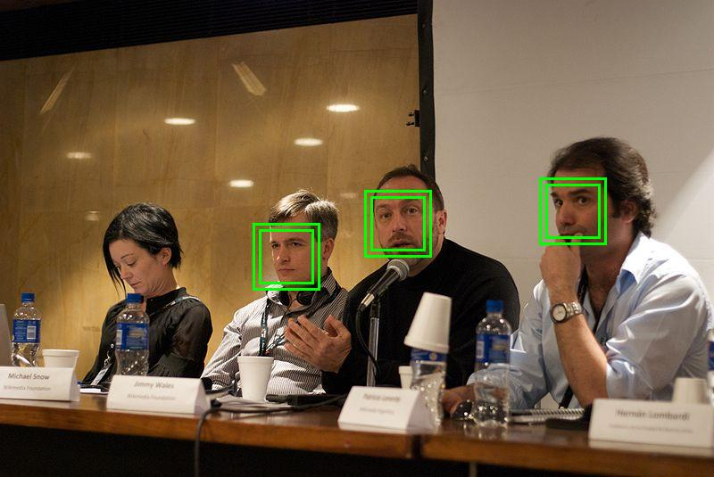
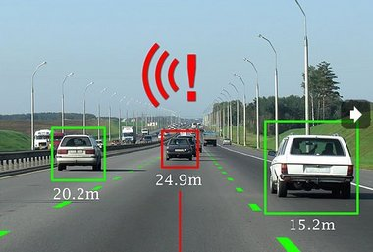

Unified Framework – Object Detection
Task description
Using a bounding box to highlight the position of a certain object in an image
E.g. A detector of Haruhi
Image
Bounding Box
Haruhi
(the girl with yellow ribbon)
Notes:
Bounding Box 使用边界的四个坐标表示，分别是
左上、右上、左下、右下
按照这种思路，能不能使用 DNN 完成这个任务了，例如 DNN 的输入是 image，输出是序列表示 左上、右上、左下、右下
使用 DNN 有一个问题，就是左边界要小于右边界，上边界要小于下边界，而 DNN 的输出是独立的，无法满足这种限制要求

Slide 6
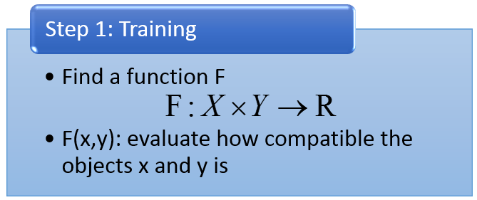



Unified Framework – Object Detection
F(x,y)
x: Image
y: Bounding Box
F(x,y)
F( )
the correctness of taking range of y in x as “Haruhi”
Notes:
the correctness of taking range of y in x as "Haruhi" 将 y 在 x 中的范围取为"Haruhi"的正确性

Slide 7

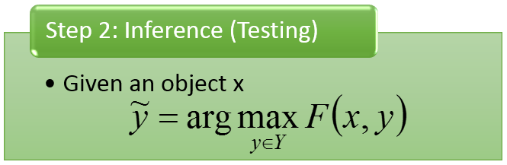


Unified Framework – Object Detection
(output result)
$$\tilde{y}$$
F(x,y)
10
3
2
……
input x =
Enumerate all possible bounding box y
-1

Slide 8



Unified Framework - Summarization
Task description
Given a long document
Select a set of sentences from the document, and cascade the sentences to form a short paragraph
long document
={s₁, s₂, s₃, ……s_{i}…}
summary
={s₁, s₃, s₅}
s_{i}: the i^{th} sentence

Slide 9





Unified Framework - Summarization
Step 1: Training
Step 2: Inference
F(x,y)
F(x,y)
x
y
x
y
d’
{s₁, s₃, s₅}
d₁
d₂
d’
{s₂, s₄, s₆}
d₁
d₂
d’
{s₃, s₆, s₉}

Slide 10
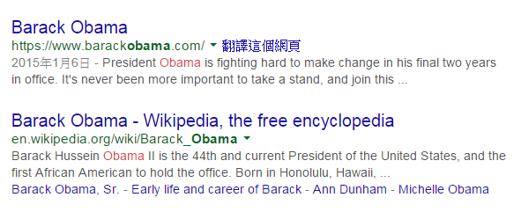
Unified Framework - Retrieval
Task description
User input a keyword Q
System returns a list of web pages
d10011
“Obama”
(keyword)
d98776
……
A list of web pages (Search Result)

Slide 11
Unified Framework - Retrieval
Step 1: Training
Step 2: Inference
F(x,y)
F(x,y)
d203
d330
……
d103
d300
……
x=“Haruhi”,
y=
d103
d300
……
x=“Obama”,
y=
x=“Bush”,
y=
d103
d304
……
x=“Haruhi”,
y=
d666
d444
……
x=“Obama”,
y=
d133
d220
……
x=“Bush”,
y=
d103
d305
……
x=“Haruhi”,
y=

Slide 12
Statistics
Step 1: Training
Estimate the probability P(x,y)
Step 2: Inference
Given an object x
Unified Framework
Step 1: Training
Find a function F
Step 2: Inference
Given an object x
F(x,y): evaluate how compatible the objects x and y is

Slide 13
Statistics
Step 1: Training
Estimate the probability P(x,y)
Step 2: Inference
Given an object x
Unified Framework
Drawback for probability
Probability cannot explain everything
0-1 constraint is not necessary
Strength for probability
Meaningful

Slide 14


Link to DNN?
The same as what we have learned.
Step 1: Training
Step 2: Inference
In handwriting digit classification, there are only 10 possible y.
y = [ 1 0 0 0 …… ]
N(x)
y = [ 0 1 0 0 …… ]
y = [ 0 0 1 0 …… ]
DNN
…
Find max
$$x$$
F(x,y)
$$x$$

Slide 15
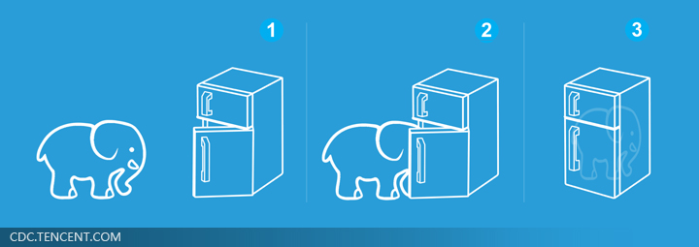
Unified Framework
Solve any tasks by two steps
Easier than putting an elephant into a refrigerator
Really?
No, we have to answer three problems.

Slide 16


Problem 1
Evaluation: What does F(x,y) look like?
How F(x,y) compute the “compatibility” of objects x and y
Object Detection:
F(x= , y= )
Summarization:
F(x= , y= )
(a long document)
(a short paragraph)
Retrieval:
F(x= “Obama” , y= )
(keyword)
(Search Result)

Slide 17
Problem 2
Inference: How to solve the “arg max” problem
The space Y can be extremely large!
Object Detection:
Y=All possible bounding box
(maybe tractable)
Summarization:
Y=All combination of sentence set in a document …
Retrieval:
Y=All possible webpage ranking ….

Slide 18
Problem 3
Training: Given training data, how to find F(x,y)
Principle
Training data:
We should find F(x,y) such that ……
……
……
for all
for all
for all

Slide 19

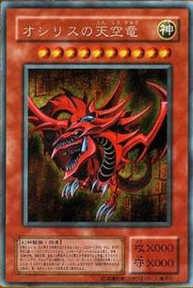
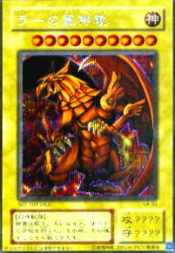
Three Problems
Problem 1: Evaluation
Problem 2: Inference
Problem 3: Training
What does F(x,y) look like?
Given training data, how to find F(x,y)
How to solve the “arg max” problem

Slide 20
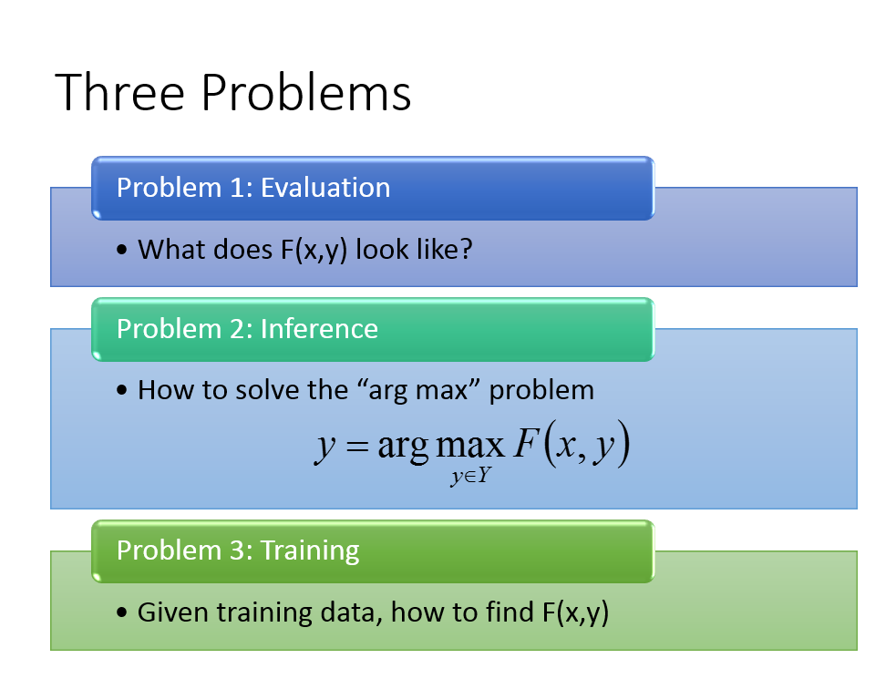
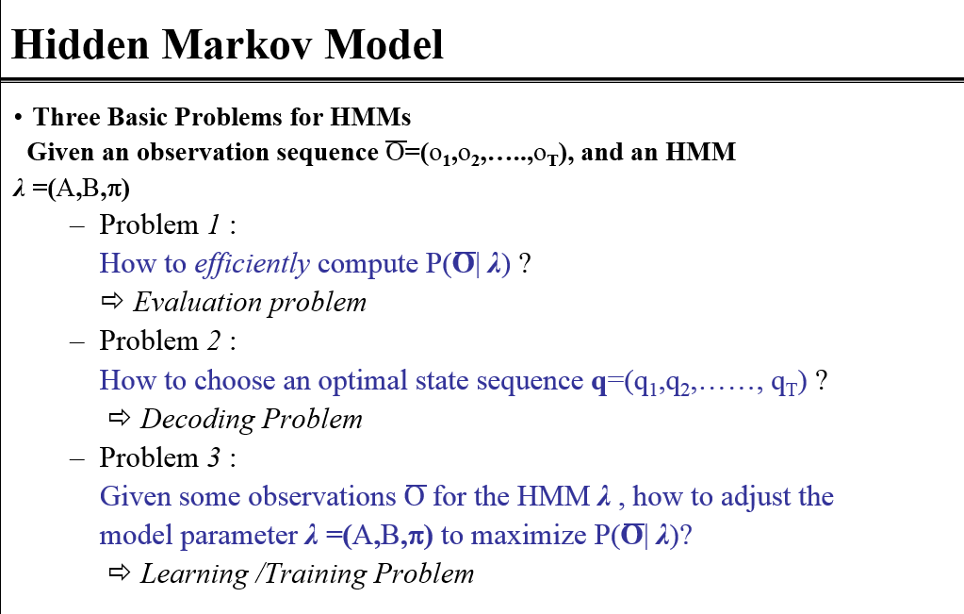
Have you heard the three problems elsewhere?
From 數位語音處理

Slide 21
Preview
Viterbi Algorithm
數位語音處理:
http://speech.ee.ntu.edu.tw/DSP2015Autumn/Videos/20150930_4.0.fsp.wmv/index.html (請用 IE 開啟)
http://speech.ee.ntu.edu.tw/DSP2015Autumn/Videos/20151007_4.0.fsp.wmv/index.html (請用 IE 開啟)
演算法
數位通信相關課程

